Slide 1



Hands-on: Explore data
MiDAS course 2024 - Day 1

Slide 2
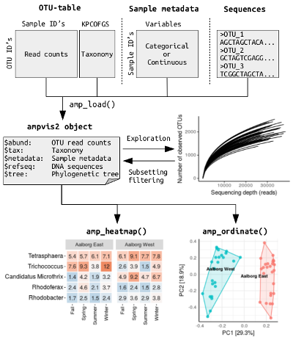
Load data into ampvis object
Metadata:
V13_metadata = 'data/V13_metadata.txt'
ASV table:
V13_ASVtab = 'data/V13_ASVtab.txt'
Taxonomy:
V13_tax = 'data/V13_ASV_MiDAS_5.3.sintax'
ASVs (fasta sequences):
ASV='data/V13_ASV.fa'
Load into ampvis:
d13 <- amp_load(otutable = V13_ASVtab,
taxonomy = V13_tax,
metadata = V13_metadata,
fasta = ASV)
(optional)

Slide 3
Explore the metadata
Answer the following questions:
Which type of samples are in the dataset?
Which country are the samples from?
How many different cities are included in the analysis?
How many sample locations are included?
How many samples have been taken in each city and when?
Try to make plots to visualise the metadata
HINT: Try looking into the data$metadata

Slide 4
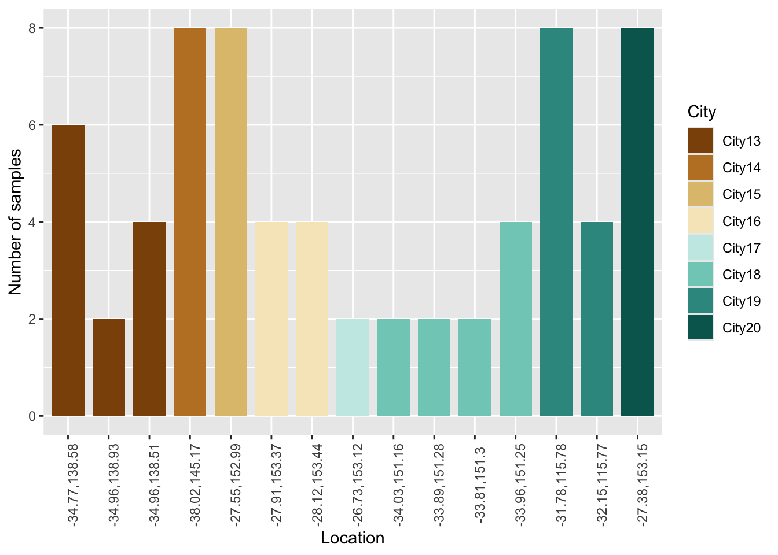
Explore the metadata
Number of samples of each WWTP

Slide 5
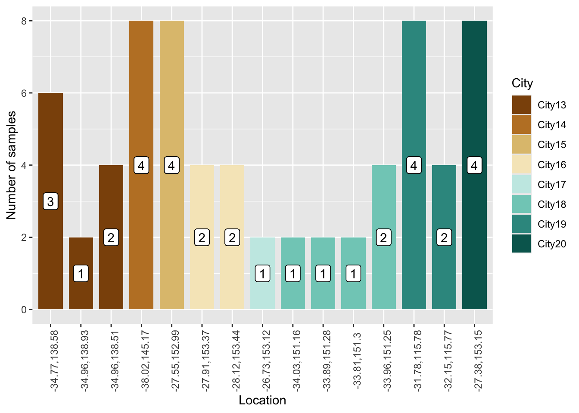
Number of samples of each WWTP
Number of tanks
Replicates for each tank

Slide 6
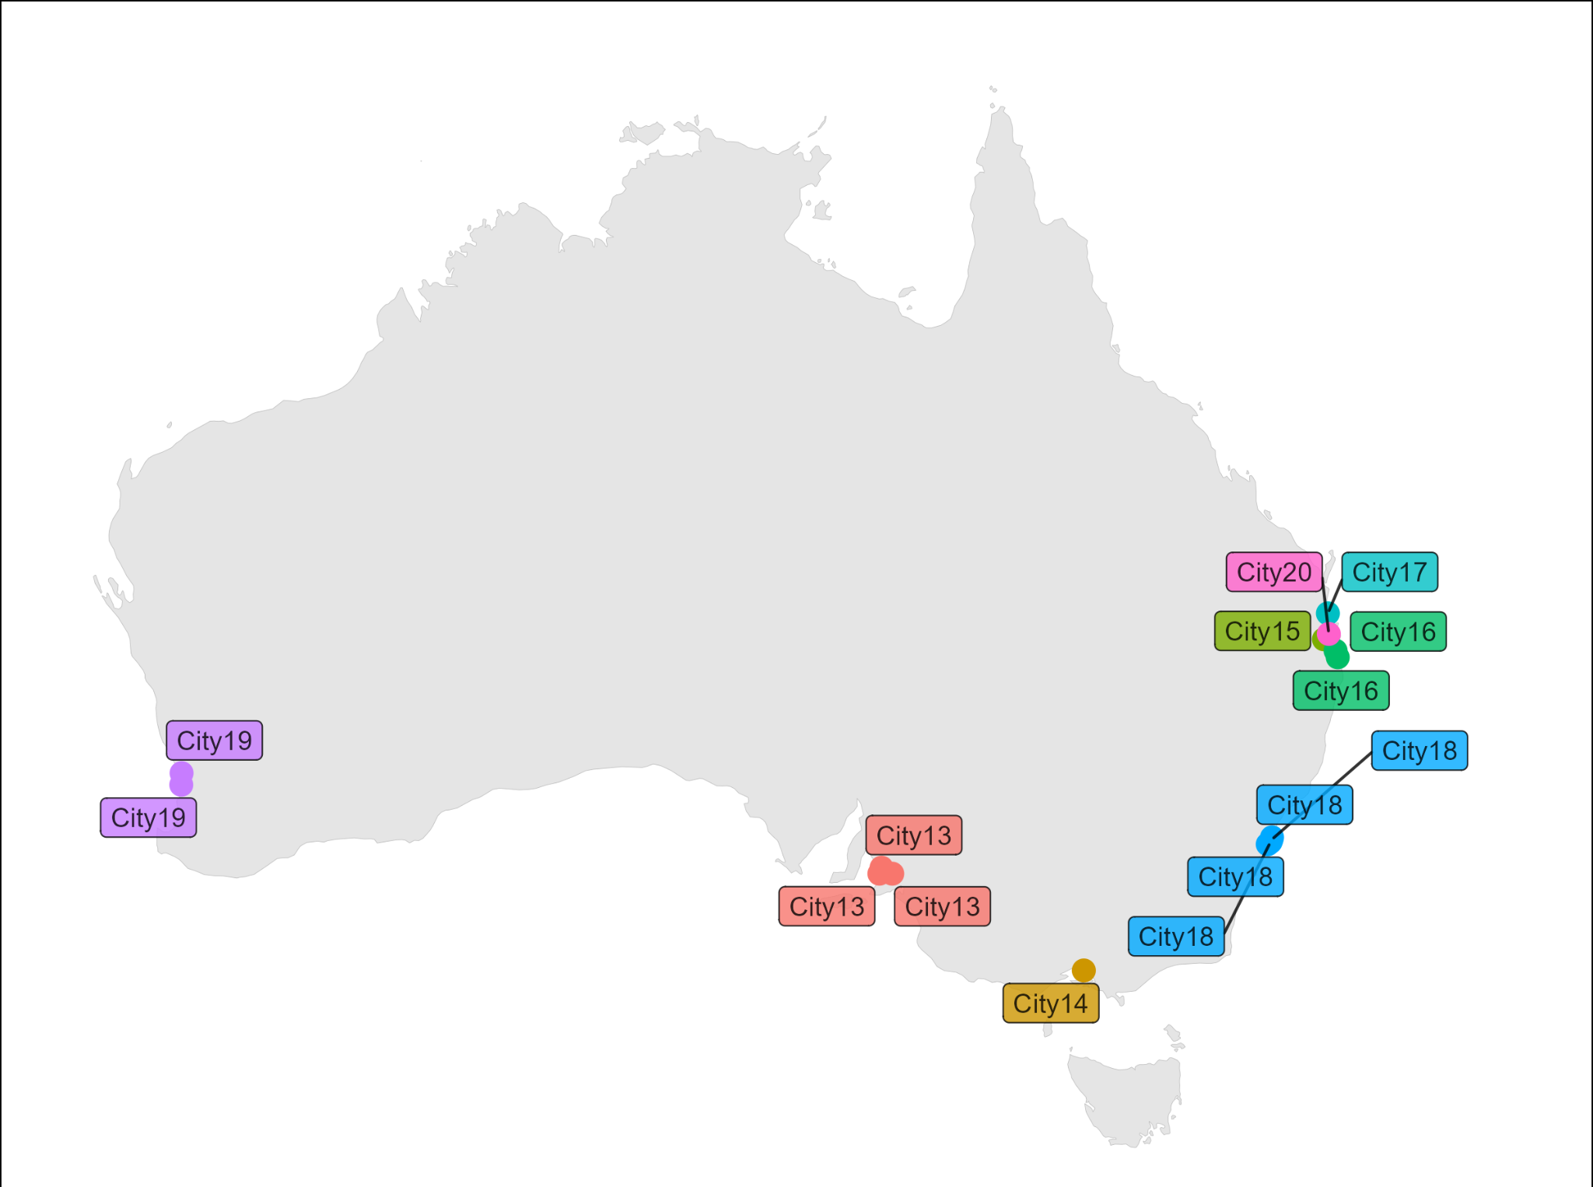
Map of sample location
Several locations in some cities

Slide 7
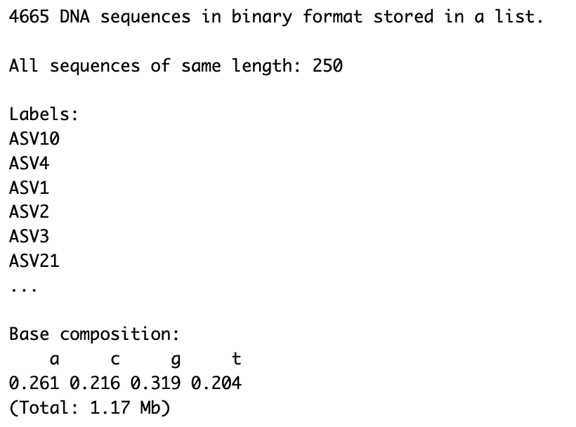
Check the amplicon sequences
Type d13$refseq to get a summary of the amplicon sequences:

Slide 8
Explore the ampvis documentation
Check out all the nice dokumentation:
https://kasperskytte.github.io/ampvis2/articles/ampvis2.html

Slide 9
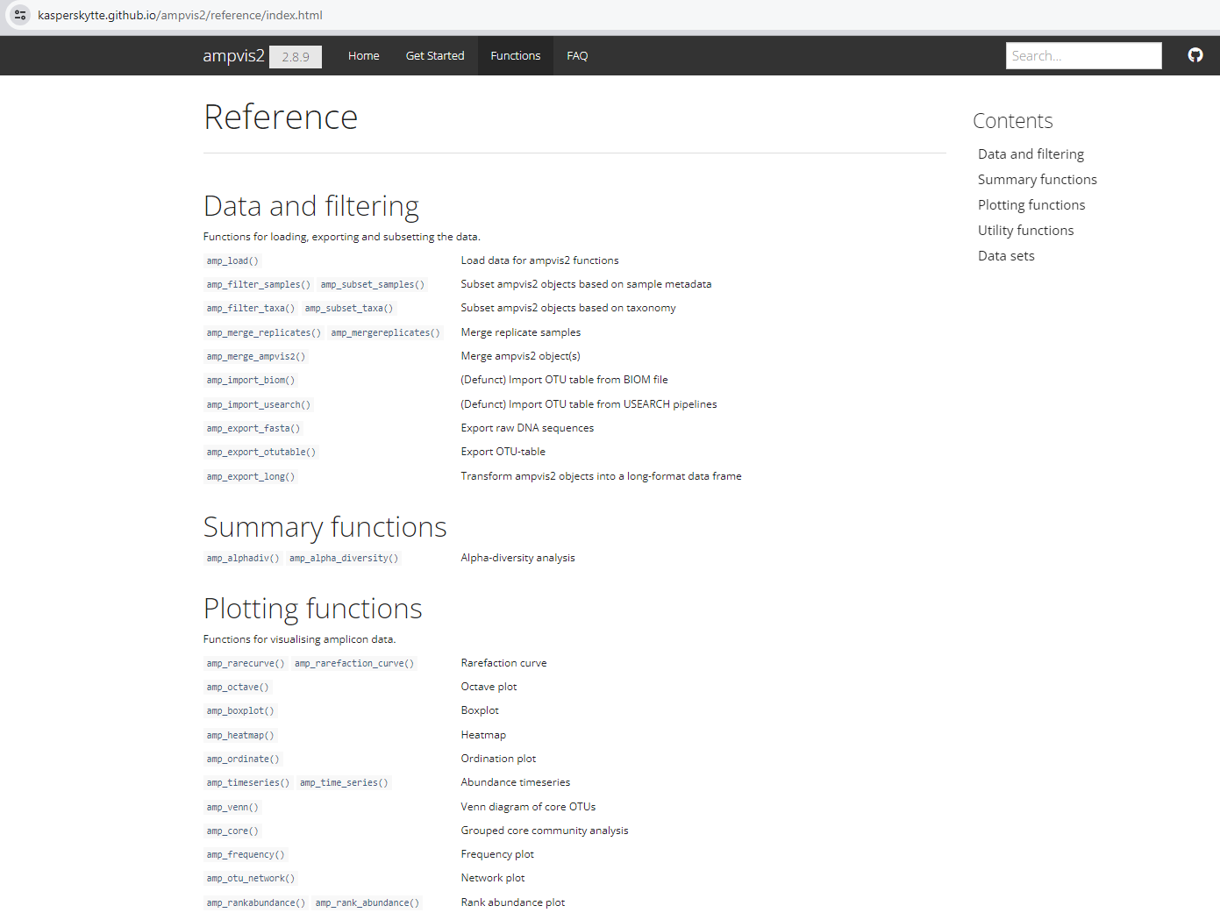
Open the website
Click on the functions!

Slide 10
Open the website
Select a function to see how to use function

Slide 11
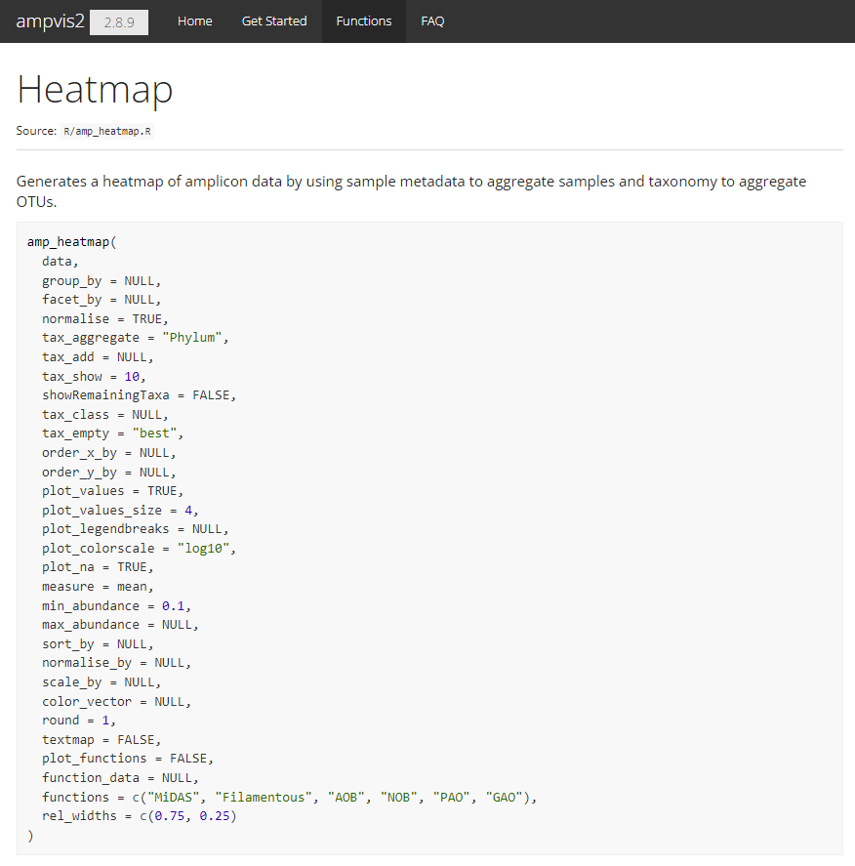
Open the website
Check out and play with all the settings

Slide 12
Now to the exercises
Check out all the nice dokumentation:
https://kasperskytte.github.io/ampvis2/articles/ampvis2.html

Slide 13
Number of reads
Answer the following questions:
What are the minimum and maximum number of reads?
Hint: print ampvis object (type name of object e.g. “d13”)
What are the minimum and maximum number of reads of city13?
Hint: try the amp_subset_samples())
Have the samples been sequenced deep enough? Should any samples be removed due to low number of reads?
Hint: try the amp_rarecurve())
Rarefy the data
Hint try the amp_subset_samples())
Check out https://kasperskytte.github.io/ampvis2/articles/ampvis2.html

Slide 14
Alpha diversity of data
Answer the following questions:
Calculate the alpha diversity (ObservedOTU, Shannon, Inverse Simpson)
HINT: Try the amp_alpha_diversity() function
Investigate the diversity across samples, locations and cities

Slide 15
Normalise the data
Answer the following questions:
Normalise the data to % read abundance
Hint try the amp_subset_samples())
Print the normalised data object

Slide 16

Most abundant bacteria
Answer the following questions:
Which bacterial taxa are the most abundant across all samples?
HINT: Try the amp_heatmap() function
HINT: Try the amp_boxplot() function
Try different grouping of data (group_by)
Try facet_by
Examine the effect of tax_show, tax_aggregate, showRemainingTaxa
Try sorting the heatmap based on a city (sort_by)
Import more data to compare with:
Silva taxonomy
V4 and V35 primer set

Slide 17
Most abundant bacteria - subset the taxa
Answer the following questions:
Which genera within Proteobacteria are the most abundant across all samples?
HINT: Try the amp_subset_taxa() function
Try making the heatmap at the different taxonomic levels
Import more data to compare with:
Silva taxonomy
V4 and V35 primer set

Slide 18
More advanced methods

Slide 19
Beta diversity
Answer the following questions:
Make a ordination plot of all samples
HINT: Try the amp_ordinate() function
Discuss what you observe from the plot
Try to color and frame by different metadata variables
HINT: Try the sample_color_by and sample_color_frame options
Try to explore the effect at different filtering and distance matrices

Slide 20
Beta diversity: Test environmental factors
Answer the following questions:
Test the effect of environmental factors in the metadata using the amp_ordinate()
HINT: Try the envfit_factor and envfit_numeric options
Discuss what you observe from the plot
Try to explore the effect at different filtering and distance matrices

Slide 21
Investigate the replicates
Answer the following questions:
How similar are the replicates?
HINT: Try the amp_ordinate() and/or amp_heatmap() function
HINT: Test co-occurence of in the amp_venn()
Try to merge the replicates
HINT: Use amp_mergereplicates()
Import more data to compare with:
Silva taxonomy
V4 and V35 primer set

Slide 22

If you have your own amplicon data, you can try doing the same analysis

